Slide 1
Lecture 5
Basic concept of Inductive Argument

Slide 2
Last Lecture
Argument could provide the reasons for the claim deductively or inductively.
For every deduction, each conclusion is logically necessary derived from the premises.
The common patters for deduction included: categorical syllogism, hypothetical syllogism, disjunctive syllogism, argument based on mathematics, argument from definition.

Slide 3
Arguments
Induction
Deduction
Common Patterns
Common Patterns
Truth and Validity
Inductive Strength

Slide 4
In this lecture, you will learn…
To know what is an inductive argument.
To know the common patterns of inductive argument.

Slide 5
Types of Argument
Deductive Argument:
Each conclusion is logically necessary derive from the premises
Given the premises, the conclusion could not possibly be false.
The denial of conclusion would fall into contradiction.
Examples:
All humans are mortal. Socrates is human. Therefore, Socrates is mortal
Tun Mahathir was PM immediately before Tun Abdullah. Tun Abdullah was PM immediately before Datuk Seri Najib. Hence, Tun Mahathir was PM before Datuk Seri Najib.
Necessary = 100%

Slide 6
Types of Argument
Inductive Argument:
Each conclusion is probably derived from the premises
Given the premises, the conclusion could possibly be false
Examples:
Every previous Prime Minister has been a man. Therefore, it is likely that the next Prime Minister will be a man.
Since the sun rose everyday morning in the past. Therefore, the sun will rise tomorrow.
Possibly = Not 100%

Slide 7
Types of Argument
Modal Indicators:
Deduction | Induction
Necessarily Certainly Definitely Absolutely Impossible | Probably Likely/unlikely Probable/improbable Plausible/implausible Reasonable to conclude

Slide 8
Types of Argument
What makes an argument inductive?
An argument is deductive if the premises can logically necessary guarantee the true of conclusion. If the premises logically possibly guarantee the true of conclusion, then it must be inductive.
The structure of argument guarantee the true conclusion possibly derived from the true premises.
The premises provides inconclusive support for the argument.

Slide 9
Arguments in Everyday
In everyday, we often use inductive argument for several reasons:
The issue we discuss is inconclusive.
It is rather hard to provide deductive argument.

Slide 10

Common Patterns of Induction

Slide 11
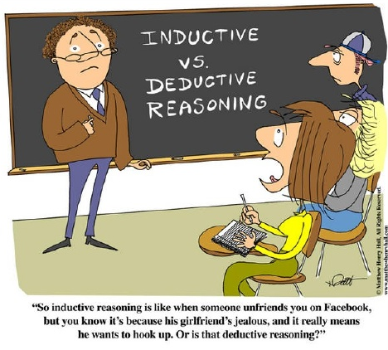
Common Patterns
Inductive Generalization
Predictive Argument
Argument from Authority
Causal Argument
Statistical Argument
Argument from Analogy

Slide 12
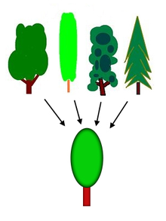
Inductive Generalization
Attributing some characteristic to all, most, or some members of a given set
To be probably true on the basis of information about some members of a particular class
Examples of Generalization:
Japanese are so polite.
Men are so unromantic!
Most students of SUC wears slipper to attend the class.

Slide 13
Inductive Generalization
Examples:
P1: Six months ago I met a farmer from Johor, and he was friendly.
P2: Four months ago I met a dentist from Johor, and he was friendly.
P3: Two months ago I met a waitress from Johor, and she was friendly.
C: I guess most people from Johor are friendly.
P1: Alpha does not invest JJPTR.
P2: Beta does not invest JJPTR.
P3: Zeta does not invest JJPTR.
C: Therefore, no students of SUC invest JJPTR.
Form of Argument:
P1: For any given set or group, A has characteristic X;
P2: B has characteristic X;
P3: C has characteristic X.
C: Therefore, the members of this set or group has characteristic X.

Slide 14

Predictive Argument
About what may or will happen in the future.
Nothing in the future is absolutely certain.
Every previous Prime Minister has been a man. Therefore, it is likely that the next Prime Minister will be a man.
It has rained in Skudai on SUC Sport Day since weather records have ever been kept. Therefore, it will probably rain in Skudai on SUC Sport Day this year.

Slide 15
Predictive Argument
However, predictive argument can be deductive:
P1: If Mr. Tan were not feeling well, then the class will be cancelled.
P2: Mr. Tan is not feeling well.
P3: Therefore, the class will be cancelled.
Remark:
The form and the evidence make the argument to be deductive.
The premises provide conclusive support.

Slide 16
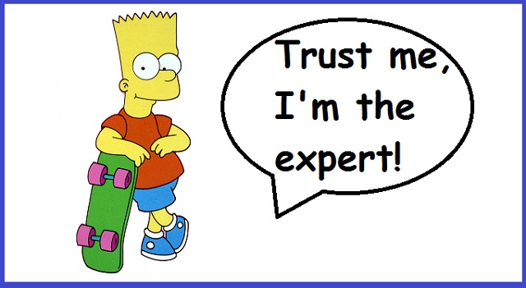
Argument from Authority
Citing some presumed authority or witness who has said that the claim is true
What is authority?
Expert knowledge
Reliable and trustworthiness
Practical
The foundation of civilization

Slide 17
Argument from Authority
According to the statistics by the Ministry of Health, Malaysians die of heart attack each year than die in car accidents. Therefore, more Malaysians die of heart attack each year than die in car accidents.
There are cobras in these woods. My neighbor said he saw one last week.
P1: Person S stated that p.
P2: S is a reliable source.
C: Therefore, p is true.

Slide 18
Argument from Authority
Can we absolute certain that authority is accurate or reliable?
How about this…
Whatever the Confucian Analects teaches is true. The Confucian Analects teaches that we should love our neighbours. Therefore, we should love our neighbors.
The premises provide conclusive support.
All A is B. C is A. Therefore, C is B.

Slide 19


Causal Argument
Comprised of causal explanation
Something causes, has caused, or will cause something else
At most time, we can never fully certain the effected cause
Examples:
I cannot log on. The network must be down.
Rashid is not allergic to peanuts. I saw him eat a bag of peanuts this morning.

Slide 20

Causal Argument
Causal arguments can be deductive:
P1: Whenever iron is exposed to oxygen, it rusts.
P2: This iron pipe has been exposed to oxygen.
C: Therefore, it will rust.
P1: If A then B
P2: A
C: Therefore, B
The structure of argument guarantee the conclusion to be true.

Slide 21
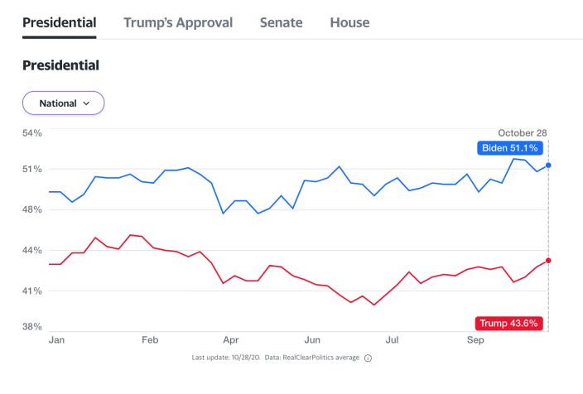
Statistical Argument
Resting on statistical evidence
Presented as probable rather than certain
P1: Eighty-five percent of SUC students are Johorians.
P2: Mike is SUC student.
C: So, Mike is probably a Johorian.
P1: According to the latest opinion polls, 51% percent of civics will vote for Biden in presidential election.
C: Therefore, Biden will be the next president of U.S.

Slide 22
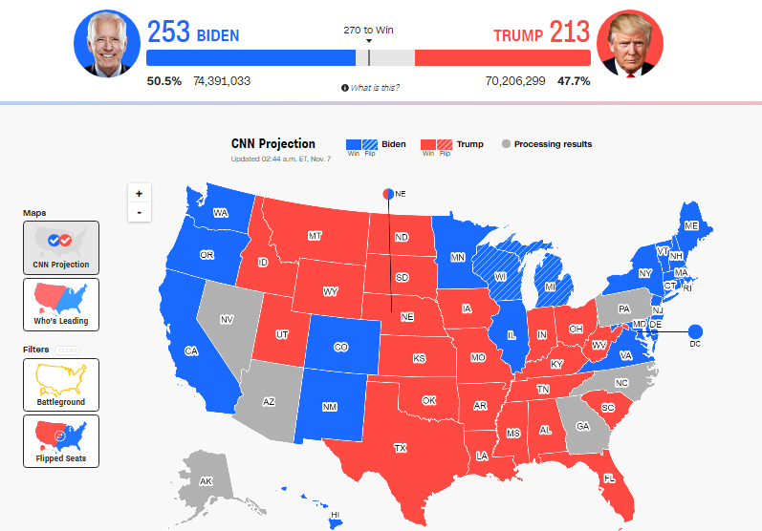
Statistical Argument
Sometimes, it can be deductive…
P1: If Trump gets at least 270 electoral votes, then he will win the election.
P2: Trumps get 306 electoral votes.
C: Therefore, Trump wins the election.
P1: If A then B
P2: A
C: Therefore, B
The premises provide conclusive support.

Slide 23
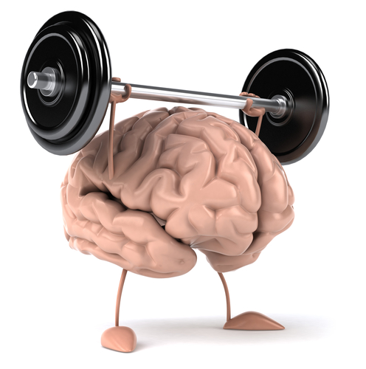
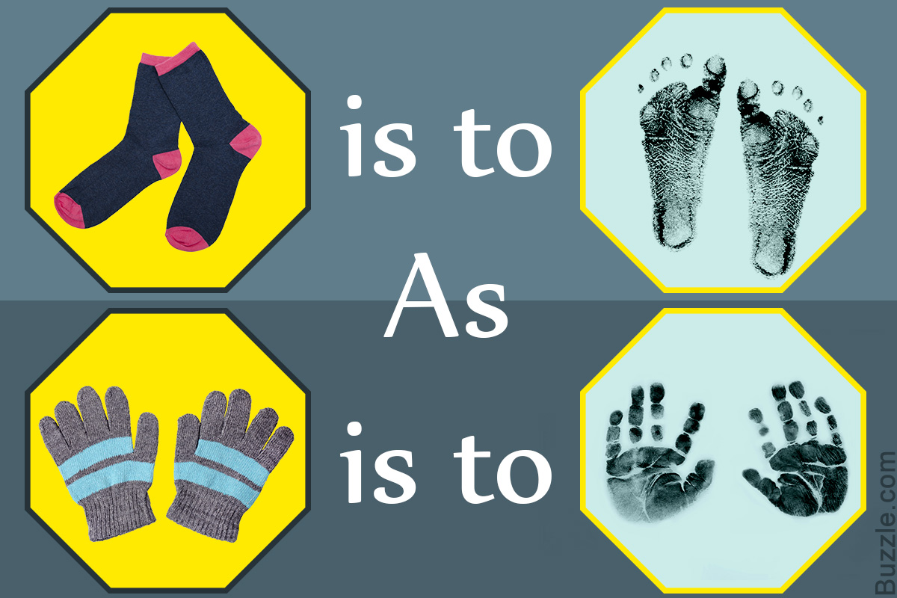
Common Patterns
(6) Argument from Analogy
Comparison of two things
To be alike in some relevant respect
Analogy:
Our brain is like a muscle.
Capitalists are like vampires.
Analogy vs. Argument from analogy
Analogy simply point out a similarity
Argument from analogy claim that certain similarities are evidence that there is another similarity

Slide 24
Common Patterns
Form:
P1: A has characteristic X; B has characteristic X
P2: A has characteristic Y.
C: Therefore, B has characteristic Y.
P1: Our muscle can be trained as fast and strong.
P2: Our brain is like a muscle.
C: Once you train it, it gets faster and stronger.
P1: Bill is a graduate of SUC, and he is bright, energetic and dependable.
P2: Zoe is a graduate of SUC, and she is bright, energetic and dependable.
P3: Mike is a graduate of SUC.
C: Therefore, most likely, Mike is bright, energetic and dependable.

Slide 25
Concluding Remarks
How to distinguish deductive from inductive arguments?
The occurrence of specific logical indicators.
The actual strength of the inferential link between premises and conclusion.
The common patterns of arguments.

Slide 26
Practice 5
The sign says it is seven miles to Lake Lily. Therefore, it is approximately seven miles to Lake Lily.
Thirty percent of Ft. Gibson residents enjoy fishing. Lonnie is a Ft. Gibson resident. So, it’s likely that Lonnie enjoys fishing.
There are no visible signs of forced entry for the door and windows. It seems certain, therefore, that the burglar had a key.
If it rains, the game will be postponed until next Saturday. According to the National Weather Service, there’s a 90 percent chance of rain. Therefore, probably the game will be postponed.
All previously observed polar bears have weighed less than 1,500 pounds. Therefore, all polar bears probably weigh less than 1,500 pounds.
I see X not wearing mask on the street. I see Y not wearing mask on the street. I see Z not wearing mask on the street. Therefore, I think most people do not wear mask on the street.
Yale is an Ivy League school, and it has a good library. Harvard is an Ivy League school, and it has a good library. Therefore, because Brown is an Ivy League school, it must have a good library, too.
Five alleged eyewitnesses have testified that they saw Frank Lane stab Melissa Jenkins. So, Frank Lane did stab Melissa Jenkins.

